Slide 1




Food Analyzer
DON BOSCO INSTITUTE OF TECHNOLOGY
Department of Computer Science and Engineering
Project Presentation on
Under the Guidance of:
Guide Name: Prof. Lakshmikantha G C
Panel Member: Prof. Manjula B S
Submitted By:
Name : Kunal K , Mahesh V Bhat, Manoj M
USN : 1DB17CS060, 1DB17CS065, 1DB17CS068

Slide 2
AGENDA
Introduction
Problem definition
Objectives
Methodology
Literature survey
System architecture
Testing and Results
Conclusions
References

Slide 3
INTRODUCTION
Nutritional components and calories are a must for the body, as they generate energy.
But it is said that an excess of anything is bad and the same applies to the intake of calories too.
If there is an excess of calories in our body, it gets stored in the form of fats, thus making us overweight.
Adult calorie requirements differ from that of a child and in the same way, the daily calorie requirement of Body Mass Index (BMI) is a person’s weight in kilograms divided by the square of their height in meters. It is one of the most commonly used ways of estimating whether a person is overweight or not.

Slide 4
People suffering from such problems require an easy way to control their calorie whereas others take it as a step towards prevention.
Thus, Maintaining a healthy diet is an important goal for many people.
To maintain a healthy diet one must know the nutrition of the food they consume.

Slide 5
PROBLEM DEFINITION
The majority of the population suffers from obesity and overweight that presents risk to health. It is a major concern that leads to serious life threatening illness like heart disease, stroke, high Blood Pressure and diabetes.
It becomes inevitable to keep track of food intake and to keep everything on track by maintaining daily food habits on a dairy.
How can we combat this through technical methods such as Machine Learning by estimating the Calories and Nutrition?

Slide 6
OBJECTIVES
To detect the image of the Food using input images.
To devise an algorithm which can accurately predict the food item from the given food image.
The project aims at estimating the calories contained in the given food item, by devising an algorithm trained on various nutritional information.
To give out calories and other nutritional values of the food.

Slide 7
METHODOLOGY
Convolutional Neural Network (CNN) Algorithm
Convolutional neural framework is one of the principal category for the photos affirmation and pictures portrayals.
The Figure 1 shows the Neural Network with various convolutional layers.
Figure 1 : CNN

Slide 8
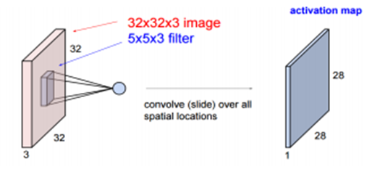
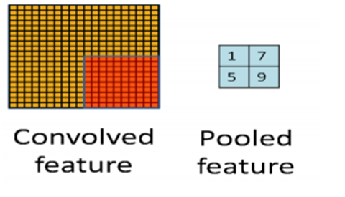
Convolution layer : This layer involves scanning the whole image for patterns and formulating it in the form of a 3x3 matrix.
Pooling layer : After the convolution comes to the pooling here the image matrix is broken down into the sets of 4 rectangular segments which are non-overlapping.
Figure 2 : Convolution layer
Figure 3 : Pooling layer

Slide 9
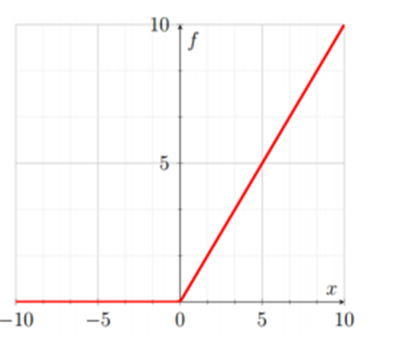
Activation layer : The used convolutional function is ReLU which allows only the positive values and then rejects the negative values.
Fully connected layer : Here the features are compared with the features of the test image and associate similar features with the specified label.
Figure 4 : Relu function

Slide 10
LITERATURE SURVEY
Convolutional Neural Network
Hokuto Kagaya and Kiyoharu Aizawa, et al proposes a method Food recognition, food detection using Convolutional Neural Network.
Advantages:
Using CNN, it occurs great accuracy in Food image recognition problems.
It has attributed large modelling capacity and significant advancement in network training.
Disadvantage:
Lack of ability to be spatially invariant to the input data.

Slide 11
Support-Vector-Machines
Hemraj Raikwar, et al proposes a model which focuses on estimation of number of calories in the food item by just taking its image as input using SVM.
Advantage:
The results show a good accuracy and support the power of SVM algorithms in pattern recognition.
Disadvantage:
Dataset limited to a subset fast food images only , hence reducing the number of classes for classification.
K-Nearest-Neighbour
Pathanjali C, et al propose an automatic food detection system that detects and recognizes varieties of Indian food.
Advantages:
For preprocessing, various image processing techniques have been considered, leading to better accuracy.
Disadvantage:
K- Nearest Neighbours (KNN) does not provide good accuracy.

Slide 12
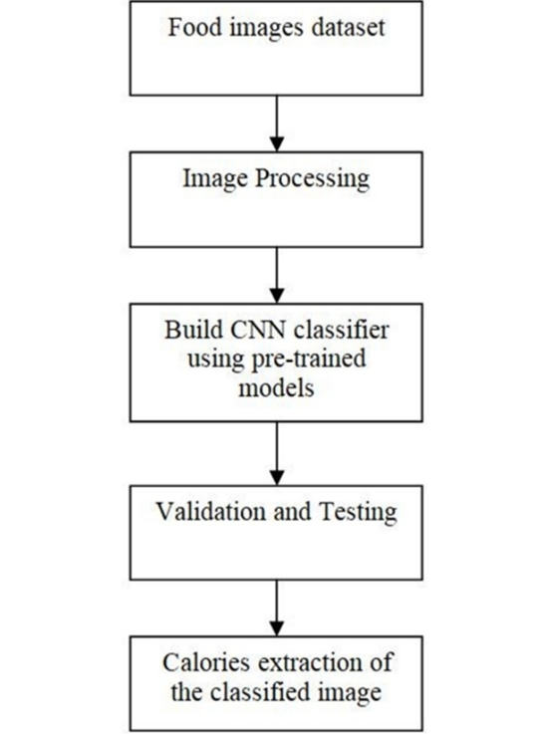
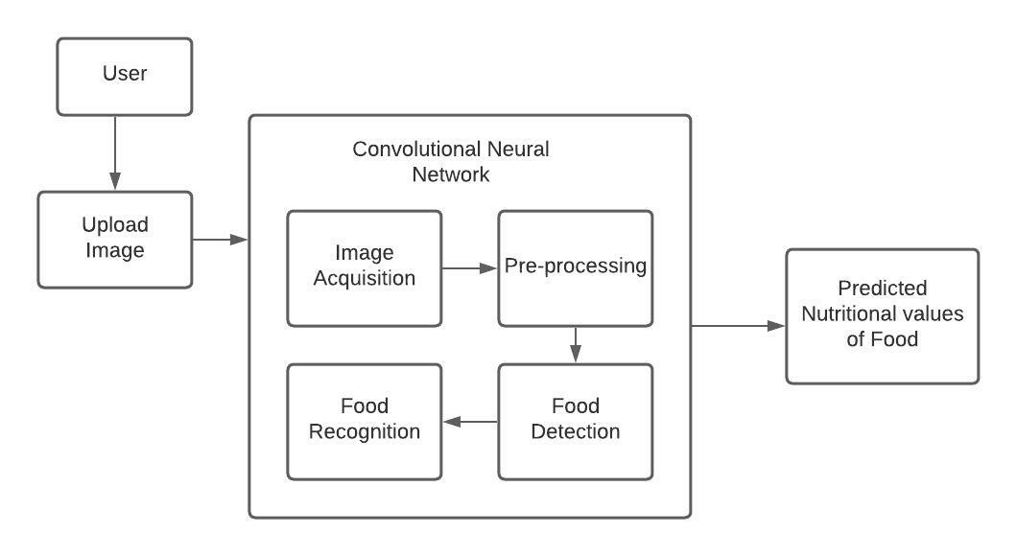
SYSTEM ARCHITECTURE AND FLOW CHART
Figure 2 : System architecture
Figure 3 : Flow chart

Slide 13
SYSTEM ARCHITECTURE
The framework can be comprehensively sorted into following significant stages:
Acquisition of image: Images are obtained either by lens or by secretly deleting them from the contraction.
Pre-Processing of image: In this process, the photo is standardized by clearing the commotion, as it may confuse the evaluation.
Data storage aspect to preserve information images for testing and training: if controlled learning will occur, as is the case here, it is important to prepare data sets. The sample database is the images collected during the photo procurement process.
Classifier to classify the FOOD: The classifier used here is the last layer of the system which gives the true probability of each experience.

Slide 14
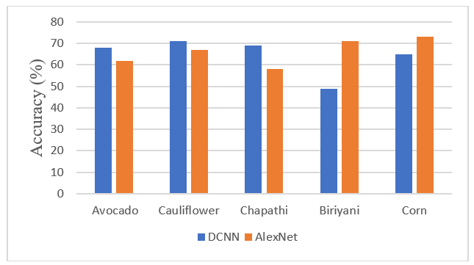
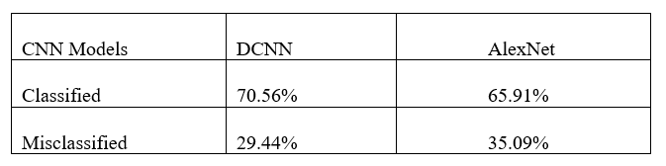
TESTING AND RESULTS
From related works of AlexNet and VGG methods, they give 47.8% and 60.81% accuracy respectively. These methods were used to classify Japanese food.
Our models, Model1 was modelled using 3150 images of fruits and vegetable datasets of 12 categories and Model2 was modelled using 18511 image datasets of 12 categories of Desi food that consists of foods like biriyani, samosa, etc.
Figure 5 : Percentage of classification on DCNN and AlexNet based top 1 accuracy
Figure 6 : Some comparison of accuracy found between different foods

Slide 15
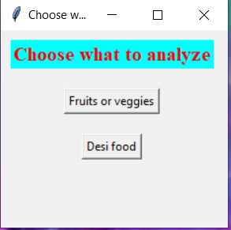
Implementation is the process of converting a new system design into an operational one. This section comprises of a detailed project appearance and overview including the analysis part.
Figure 4 represents the initial page of the food analyzer where the user can choose between the type of food to be detected and evaluated.
Figure 7: first page GUI snapshot

Slide 16
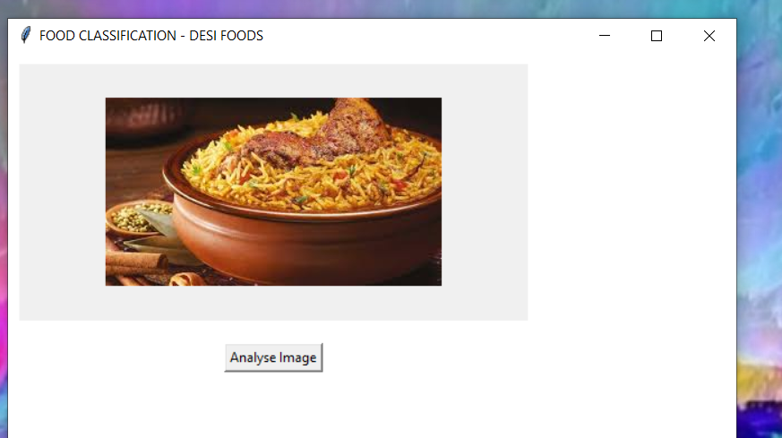
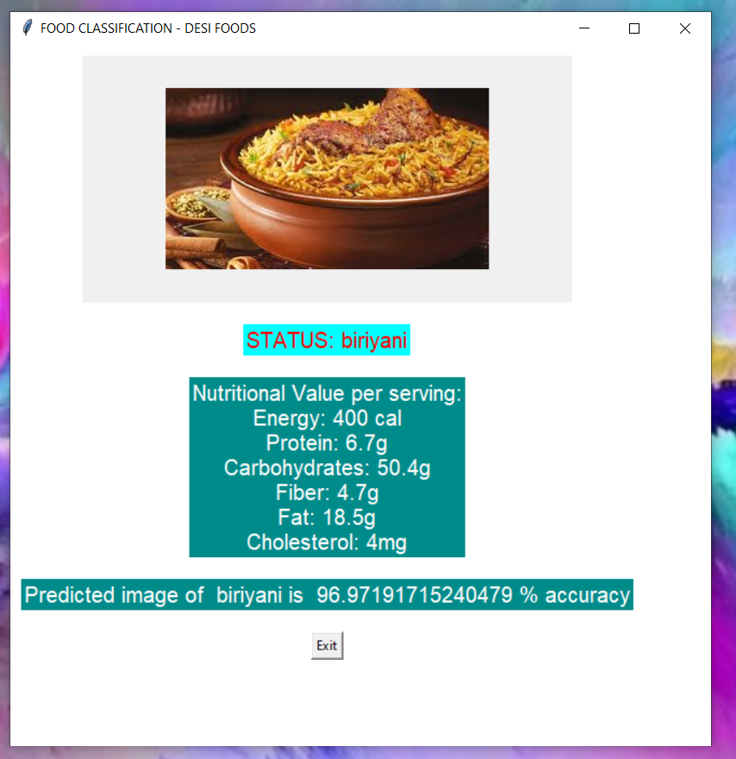
Figure 8 : Choosing an image to classify (snapshot)
Figure 9 : Classified image with
Nutritional values (snapshot)

Slide 17
CONCLUSION
In this research study of the Convolutional Neural Network, Deep learning technique is used to classify the food images into their respective classes and also predict the nutritional values of the food image.
The accuracy found in food images recognition was found to be considerable.
As far as the future enhancement is concerned, the same research can be carried out on larger dataset with more number of classes and more number of images in each class, as larger dataset improves the accuracy by learning more features and reduces the loss rate.

Slide 18
REFERENCES
[1] Jingjing Chen, Chong-Wah Ngo- “Deep-based Ingredient Recognition for Cooking Recipe Retrieval”
[2] Viswanath C Burkapalli, Priyadarshini C Patil- “An Efficient Food Image Classification By Inception-V3 Based CNN” (2020)
[3] Manpreetkour Basantsingh Sardar1, Dr. Sayyad D. Ajij2- “Fruit Recognition and its Calorie Measurement: An Image Processing Approach” (2016)
[4] Pathanjali C, Vimuktha E Salis, Jalaja G, Latha A- “A Comparative Study of Indian Food Image Classification Using K-Nearest-Neighbour and Support-Vector-Machines” (2019)
[5] Hemraj Raikwar and Himanshu Jain- “Calorie Estimation from Fast Food Images Using Support Vector Machine” (2018)
[6] Hokuto Kagaya and Kiyoharu Aizawa- “Food Detection and Recognition Using Convolutional Neural Network” The University of Tokyo.
[7] Thai Alimentation Image Classification by NaritHnoohom and SumethYuenyong
[8] Mohammed A. S ubhi and Sawal Md.Ali – “A Deep Convolutional Neural Network for Food Detection and Recognition”
[9] J. D. A. Berg and L. Fei-Fei, “Large scale visual recognition challenge 2010” http://imagenet.org/download, 2010, [Online;accessed 29-Jan-2018]
[10] Szegedy, C., Vanhoucke, V., Ioffe, S., Shlens, J., Wojna, Z.(2016) “Rethinking the inception architecture for computer vision. InProceedings of the IEEE conference on computer vision and pattern recognition (pp.2818-2826)”

Slide 19
THANK YOU

